Slide 1

Algebra 1
Unit 1, Lesson 3 Interpreting Function Notation in the Real World Volume 1, pg. 16

Slide 2


Benchmark
MA.912.F.1.2
Given a function represented in function notation, evaluate the function for an input in its domain. For a real-world context, interpret the output.
volume 1, pg. 16

Slide 3
Integrated Mathematical Thinking and Reasoning Standards
MA.K12.MTR.1.1 Actively participate in effortful learning both individually and collectively.
MA.K12.MTR.2.1 Demonstrate understanding by representing problems in multiple ways.
MA.K12.MTR.3.1 Complete tasks with mathematical fluency.
MA.K12.MTR.4.1 Engage in discussions that reflect on the mathematical thinking of self and others.
MA.K12.MTR.6.1 Assess the reasonableness of solutions.
MA.K12.MTR.7.1 Apply mathematics to real-world contexts.
volume 1, pg. 16

Slide 4

Learning Target
I can evaluate a function for a specific input value of the domain and interpret it in a real-world context.
volume 1, pg. 16

Slide 5

Warm-Up
volume 1, pg. 16

Slide 6
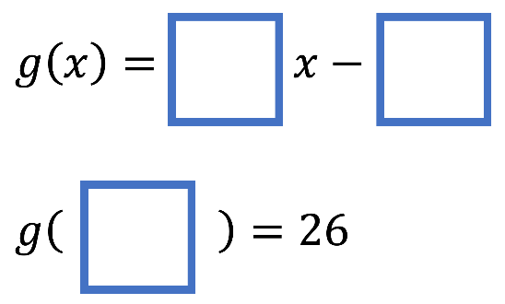
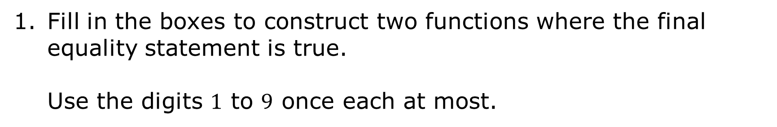
1.3.1 Warm-Up: Equivalent Function Values
Fill in the boxes to construct two functions where the final equality statement is true.
Use the digits $1$ to $9$ once each at most.
volume 1, pg. 16
Notes:
Video Link: https://algebranation.wistia.com/medias/fi4fidi5y8

Slide 7

Guided Instruction
volume 1, pg. 17

Slide 8

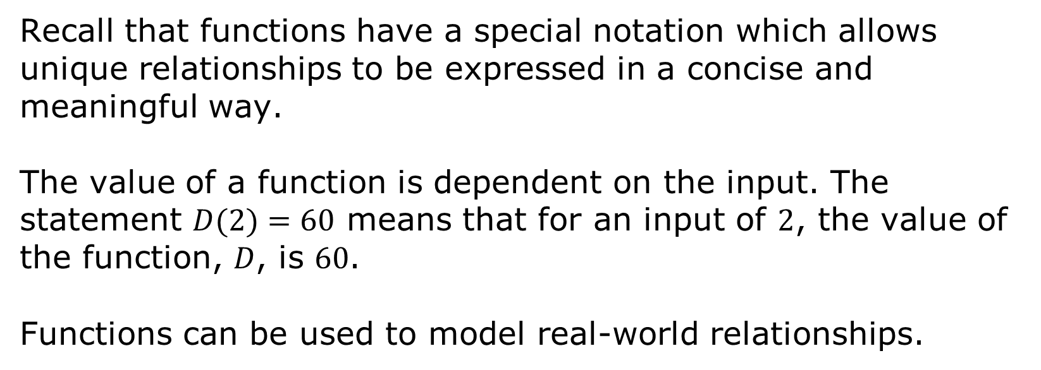
1.3.2 Guided Instruction: Interpreting Functions
Recall that functions have a special notation which allows unique relationships to be expressed in a concise and meaningful way.
The value of a function is dependent on the input. The statement $D(2)=60$ means that for an input of $2$, the value of the function, 𝐷, is $60$.
Functions can be used to model real-world relationships.
volume 1, pg. 17

Slide 9
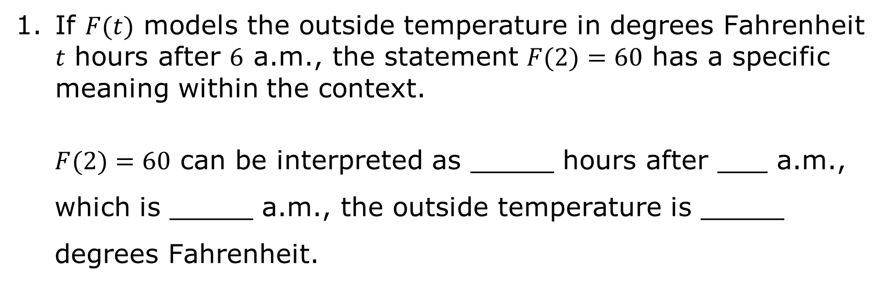
If $F(t)$ models the outside temperature in degrees Fahrenheit 𝑡 hours after $6$ a.m., the statement $F(2)=60$ has a specific meaning within the context.
$F(2)=60$ can be interpreted as _____ hours after ___ a.m., which is _____ a.m., the outside temperature is _____ degrees Fahrenheit.
volume 1, pg. 17

Slide 10
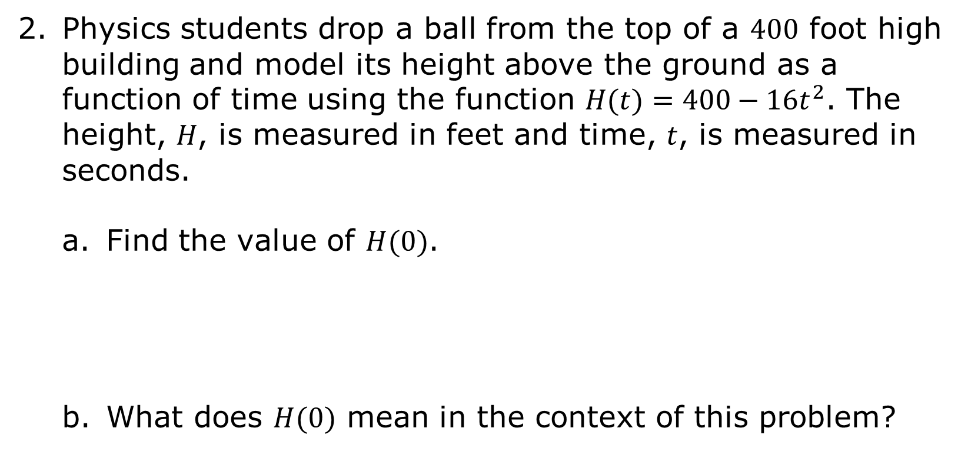
Physics students drop a ball from the top of a $400$ foot high building and model its height above the ground as a function of time using the function $H(t)=400−16t^{2}$. The height, 𝐻, is measured in feet and time, 𝑡, is measured in seconds.
Find the value of $H(0)$.
What does $H(0)$ mean in the context of this problem?
volume 1, pg. 17

Slide 11
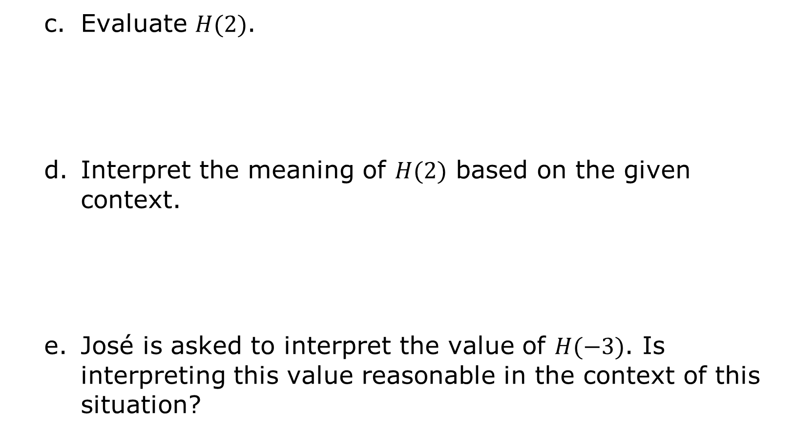
Evaluate $H(2)$.
Interpret the meaning of $H(2)$ based on the given context.
José is asked to interpret the value of $H(−3)$. Is interpreting this value reasonable in the context of this situation?
volume 1, pg. 17

Slide 12
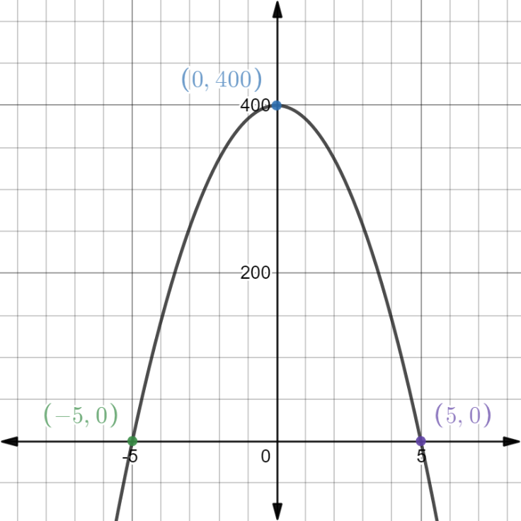
The graph of 𝐻(𝑡) is shown on the coordinate grid.
Based on the context, the 𝑥-axis represents ______________ and the 𝑦-axis represents _______________.
What will the height of the ball be when it hits the ground?
Circle the point where the ball will hit the ground.
volume 1, pg. 18

Slide 13
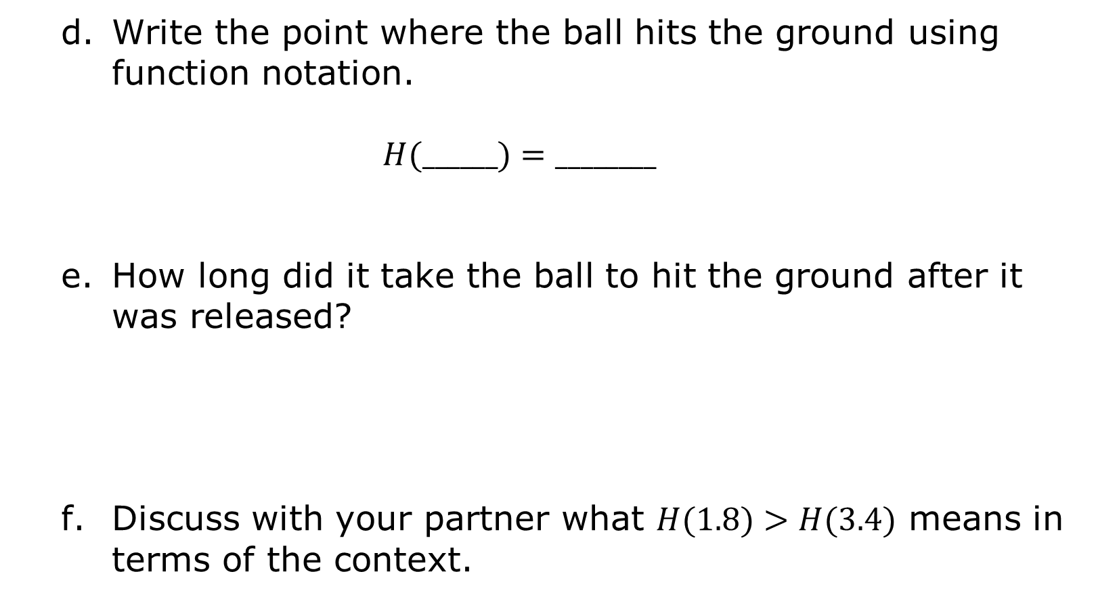
Write the point where the ball hits the ground using function notation.
$$H(______)=________$$
How long did it take the ball to hit the ground after it was released?
Discuss with your partner what $H(1.8)>H(3.4)$ means in terms of the context.
volume 1, pg. 18

Slide 14

Guided Practice
volume 1, pg. 19

Slide 15

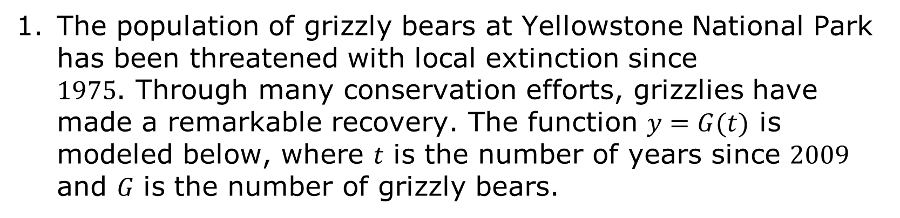
1.3.3 Guided Practice: Interpreting Functions
The population of grizzly bears at Yellowstone National Park has been threatened with local extinction since $1975$. Through many conservation efforts, grizzlies have made a remarkable recovery. The function $y=G(t)$ is modeled below, where 𝑡 is the number of years since $2009$ and 𝐺 is the number of grizzly bears.
volume 1, pg. 19

Slide 16
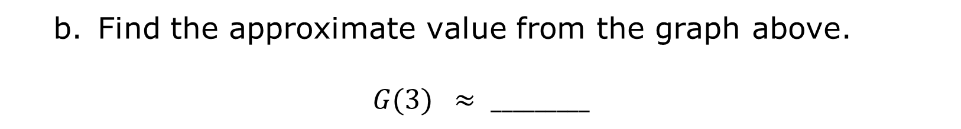
Label the 𝑥 and 𝑦 axes based on the context.
Find the approximate value from the graph above.
$$G(3) ≈ _________$$
volume 1, pg. 19

Slide 17
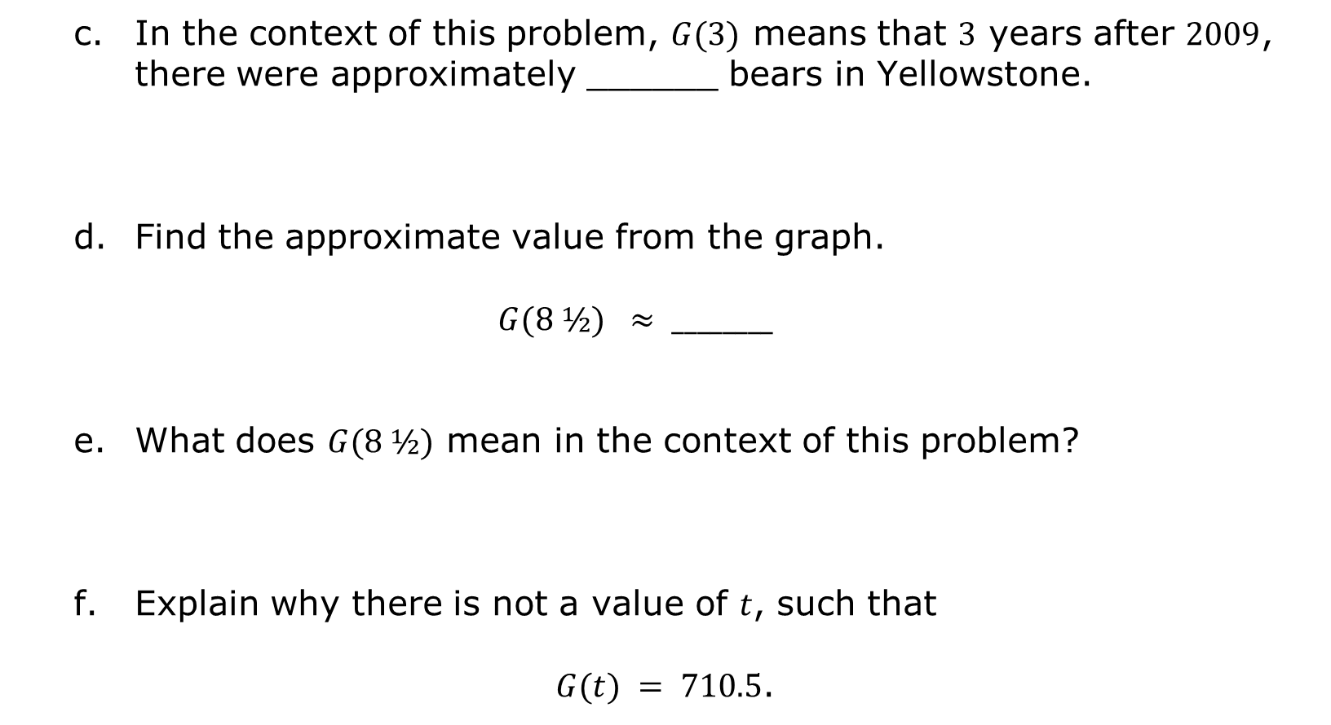
In the context of this problem, $G(3)$ means that $3$ years after $2009$, there were approximately ______ bears in Yellowstone.
Find the approximate value from the graph.
$$G(8 ½) ≈ ________$$
What does $G(8 ½)$ mean in the context of this problem?
Explain why there is not a value of 𝑡, such that
$G(t) = 710.5$.
volume 1, pg. 19

Slide 18
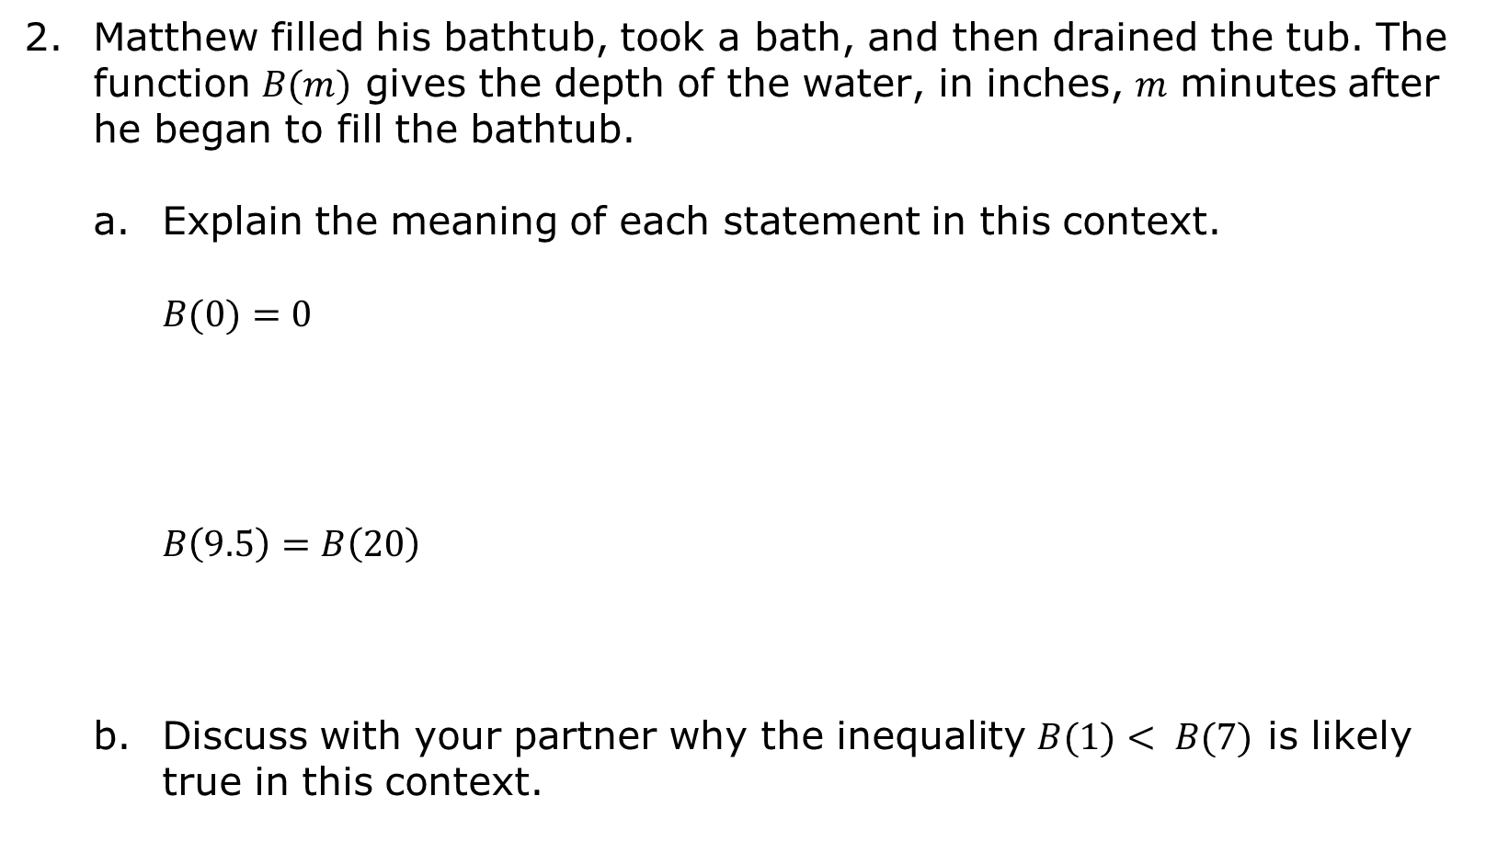
Matthew filled his bathtub, took a bath, and then drained the tub. The function $B(m)$ gives the depth of the water, in inches, 𝑚 minutes after he began to fill the bathtub.
Explain the meaning of each statement in this context.
$$B(0)=0$$
$$B\left(9.5\right)=B\left(20\right)$$
Discuss with your partner why the inequality $B(1)< B(7)$ is likely true in this context.
volume 1, pg. 20

Slide 19
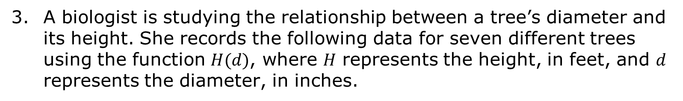
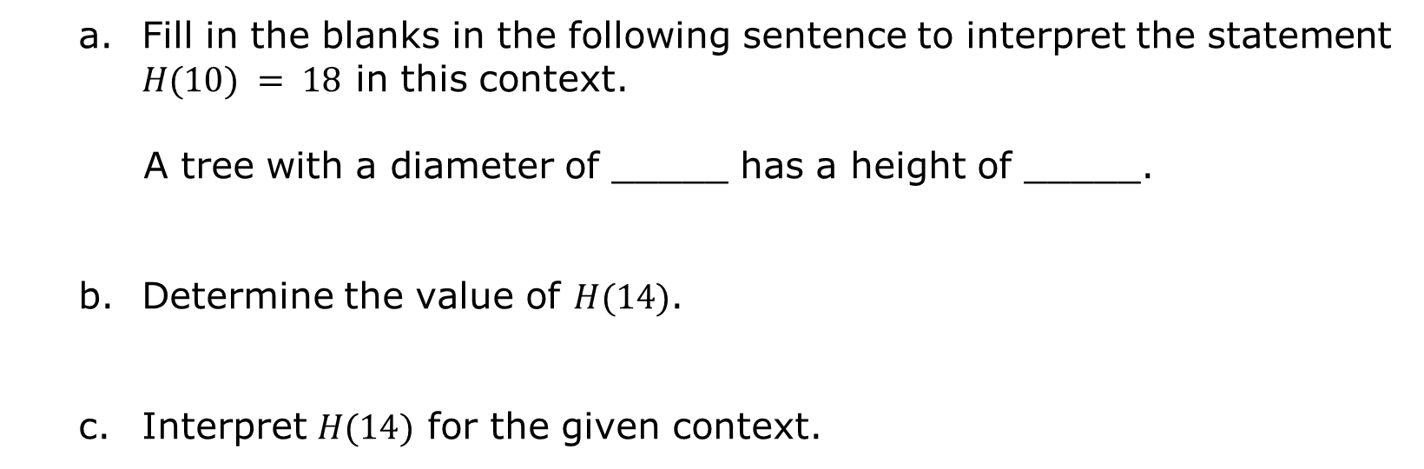
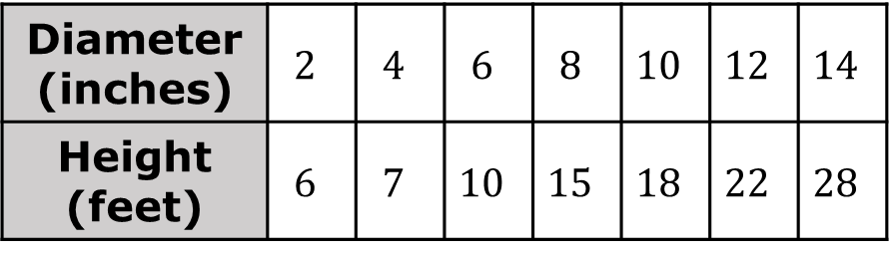
A biologist is studying the relationship between a tree’s diameter and its height. She records the following data for seven different trees using the function $H(d)$, where 𝐻 represents the height, in feet, and 𝑑 represents the diameter, in inches.
Diameter (inches) | $$2$$ | $$4$$ | $$6$$ | $$8$$ | $$10$$ | $$12$$ | $$14$$
Height (feet) | $$6$$ | $$7$$ | $$10$$ | $$15$$ | $$18$$ | $$22$$ | $$28$$
Fill in the blanks in the following sentence to interpret the statement $H(10) = 18$ in this context.
A tree with a diameter of _____ has a height of _____.
Determine the value of $H(14)$.
Interpret $H(14)$ for the given context.
volume 1, pg. 20

Slide 20

Try It
volume 1, pg. 21

Slide 21
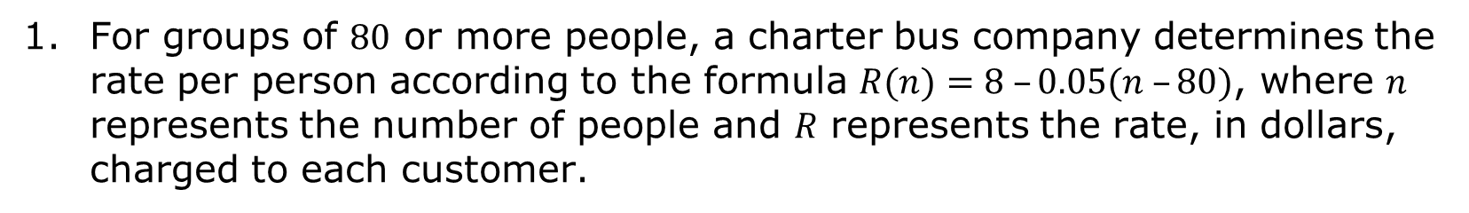
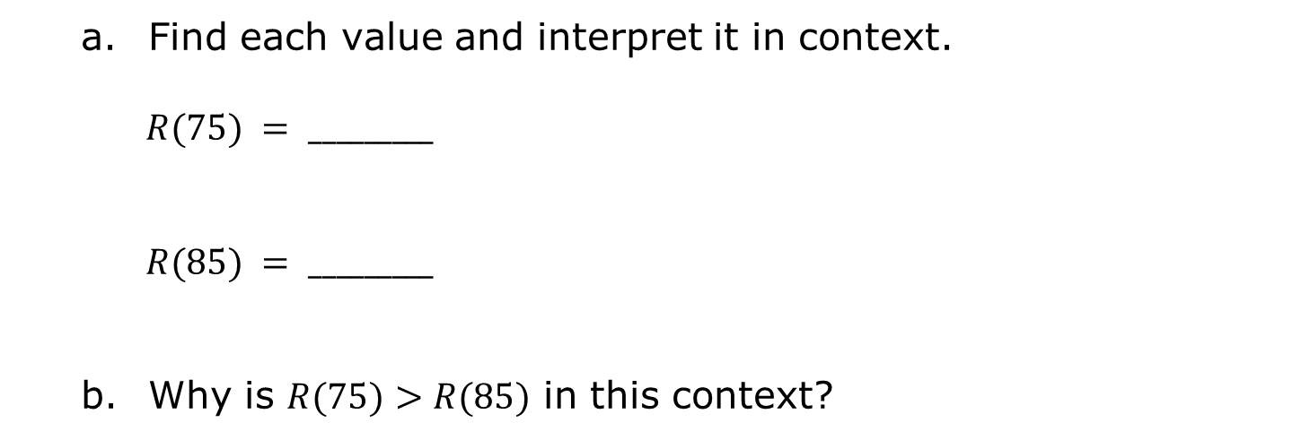
1.3.4 Try It: Evaluating and Interpreting Functions
For groups of $80$ or more people, a charter bus company determines the rate per person according to the formula $R(n)=8 –0.05(n –80)$, where 𝑛 represents the number of people and 𝑅 represents the rate, in dollars, charged to each customer.
Find each value and interpret it in context.
$$R(75) = _________$$
$$R(85) = _________$$
Why is $R(75)>R(85)$ in this context?
volume 1, pg. 21

Slide 22

Your Turn
volume 1, pg. 21

Slide 23

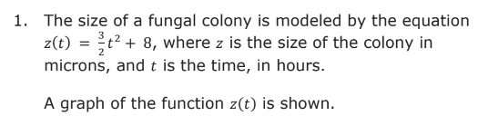
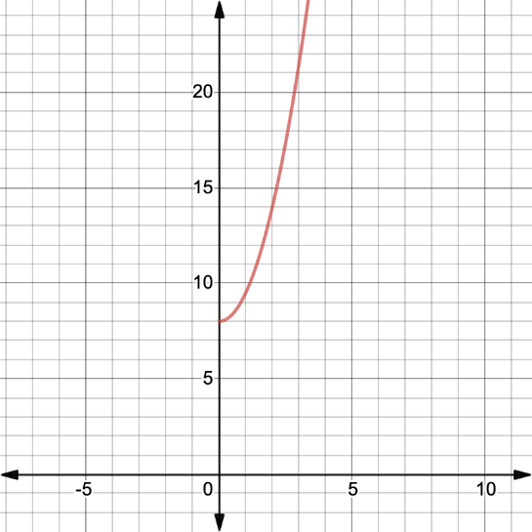
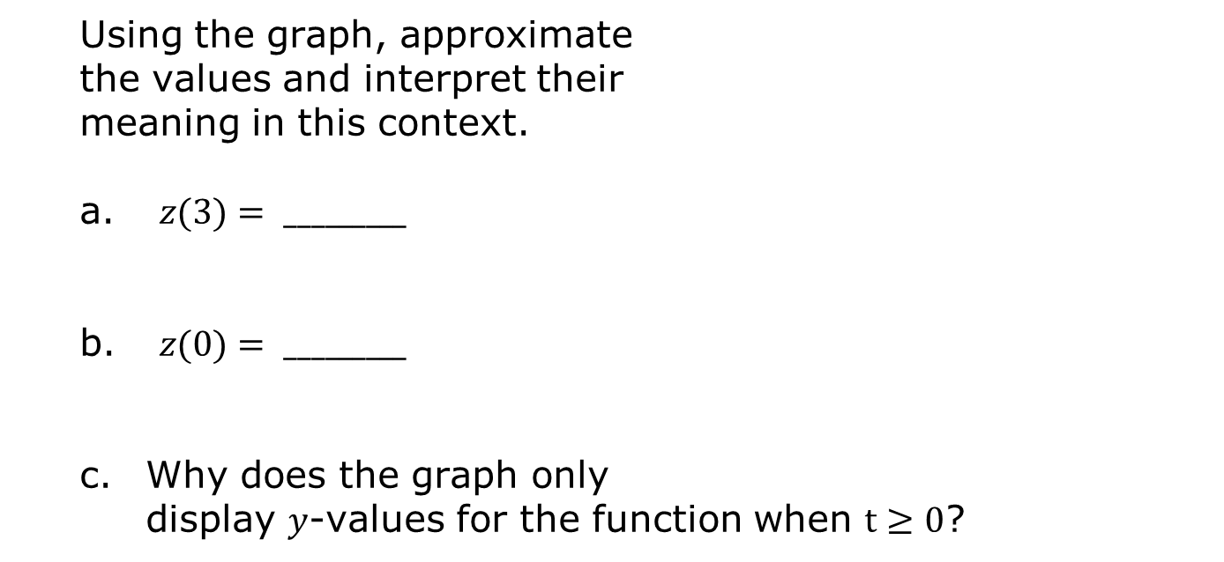
1.3.5 Your Turn!
Using the graph, approximate the values and interpret their meaning in this context.
$z(3)= _________$
$z(0)= _________$
Why does the graph only display 𝑦-values for the function when $t≥0$?
volume 1, pg. 21

Slide 24

Wrap-Up
volume 1, pg. 22

Slide 25
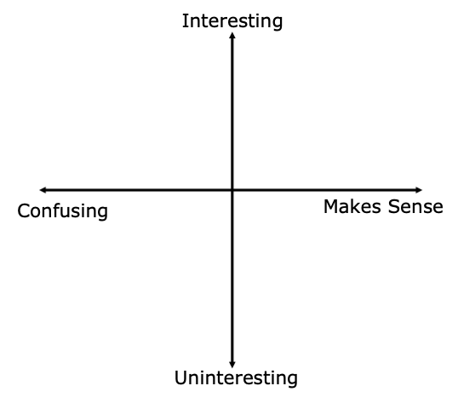
1.3.6 Wrap-Up: Reflection
Plot a point in one of the quadrants below to indicate where you feel you are on today’s learning target: “I can evaluate a function for a specific input value of the domain and interpret it in a real-world context.”
volume 1, pg. 22

